Slide 1
Introduction to Options
Amherst College Quantitative Trading Club, October 12th, 2020

Slide 2
Announcements
Traders@MIT
Partners will be released tomorrow afternoon or Wednesday morning.
Everyone must submit their own application to Traders@MIT by Friday, only after being notified by us about pairings.

Slide 3
Brainteaser of the Week
There are 251 “bad guys” in a room and there are 250 “good guys” outside the room.
The bad guys are all lined up in a straight line, and every “bad guy” has on a hat. One of the “bad guys” is called the “captain,” and his position in the line is unknown.
When a “good guy” walks in, a random bad guy (who is NOT the captain) waves at the good guy. Then, the good guy assigns a color (black or white) to the “bad guys” hat.
This process repeats until the 250th good guy walks in. At this point, only the “bad guy captain” is left, and the “bad guy captain” is allowed to choose his color without waving at the final good guy (ie, the good guy does not know what color he sets).
The final “good guy” is now tasked with determining who the “bad guy captain” is.
How can the final “good guy” construct as small as possible a subset of “bad guys” that would absolutely contain the “bad guy captain”?

Slide 4
Answer
Split the 251 Bad Guys into groups of 15 or 16
First 5 groups should be 15 and the last 11 groups should be size 16, for a total of 16 groups
The easiest way to do this is to count off (so, the first fifteen people are in group 1, etc)
For a given Good Guy, we follow this strategy
Observe the waving Bad Guy and his position in his group. If all other people have been given hats in his group, give him a black hat. Otherwise, given him a white hat.
What does the Bad Buy Captain see when he needs to choose his color?
Every group will have one black hat in a group of white hats, except for one group, which will be all white (and must contain the Bad Guy from the strategy above)
What can the Bad Guy Captain do?
Bad Guy captain chooses BLACK: Then, the Bad Guy captain must be in the group of 16 people with a Black Hat. We can guess which person is him 1/16 of the time.
Bad Guy captain chooses WHITE: Then, the Bad Guy captain must be in his group of entirely White Hats, and we guess who he is at most 1/16 of the time.

Slide 5
What is an Option?
The right to take an action
Owning an option gives you that right
Selling an option means you sold your rights to a counterparty, so you are left with an obligation to fulfill those rights
Call - buy, put - sell
Usually covers a “round lot” aka 100 shares of something

Slide 6
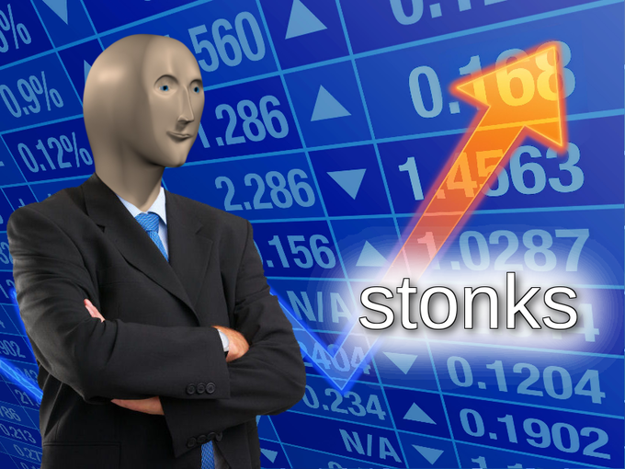
Why Options?
Insurance aka hedging
Smoother execution (liquidity, price slippage, etc.)
BETS
Notes:
Slippage

Slide 7
Basic Market Structure
Listed on the CBOE (stocks and indices), Chicago Mercantile Exchange, CME & Chicago Board of Trade, CBOT (futures)
60% close
10% exercise
30% WORTHLESS, -100%
Equity options are American-style; index options are European-style
Designated market maker, very little liquidity risk
OTC markets exist, mostly for European style, more expensive
Notes:
closed out prior to expiration means a seller who sold-to-open a contract buy-to-close prior to expiration, rather than holding the contract through to expiration.

Slide 8
Pricing Factors for Options
Price of underlying asset, S
Strike price of option, X
Time to maturity, T - t
Variance of continuously compounded returns of the underlying, 𝜎^2
Continuous compound: exp(r1 * r2 * … rn)
Riskless interest rate, r
Present value of dividends from t to T, D
These affect the intrinsic value, which may not align with the price you pay

Slide 9
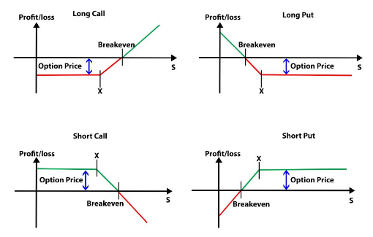
Source: Quantra
Review: Option Payoff
An option payoff diagram is a graphical representation of the net Profit/Loss made by the option buyers and sellers.
S = Underlying Price
X = Strike Price
A break even point is the point at which you make no profit or no loss. Option Premium is the upfront payment made by the option buyer to the option seller to acquire the option.
Notes:
https://www.khanacademy.org/economics-finance-domain/core-finance/derivative-securities/put-call-options/v/put-payoff-diagram
https://quantra.quantinsti.com/glossary/Option-Payoff

Slide 10
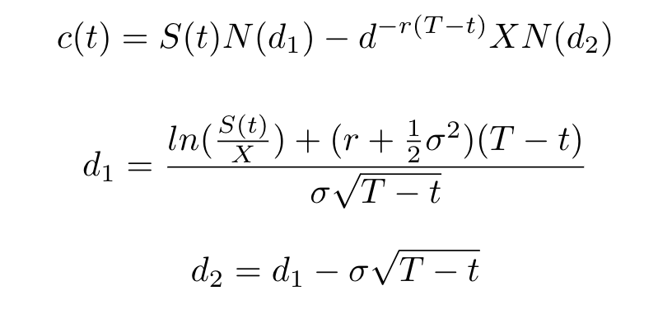
Basic Black Scholes

Slide 11
Black Scholes Assumptions
Derived from a bond and a stock
No transaction costs or taxes
All securities are perfectly divisible (could buy half a stock)
Stock pays no dividends
Security trading is continuous in time
You could trade at t1 and t2 ⇒ You can trade at any t satisfying t1 <= t <= t2
Both the bond and the stock could be sold short with NO restrictions
Riskless interest rate r is constant
This is (hopefully) obvious useless

Slide 12
So...How to Price?
DCF does NOT work (you don’t know the discount rate since the variable is path-dependent)
Numerical Monte Carlo simulation (relies on risk-neutral valuation i.e. price = discounted expected value)
Lattice/Binomial (discrete time model, allows for early exercise)
If anybody actually knows they would have a Nobel Prize now
Notes:
https://en.wikipedia.org/wiki/Monte_Carlo_methods_for_option_pricing

Slide 13
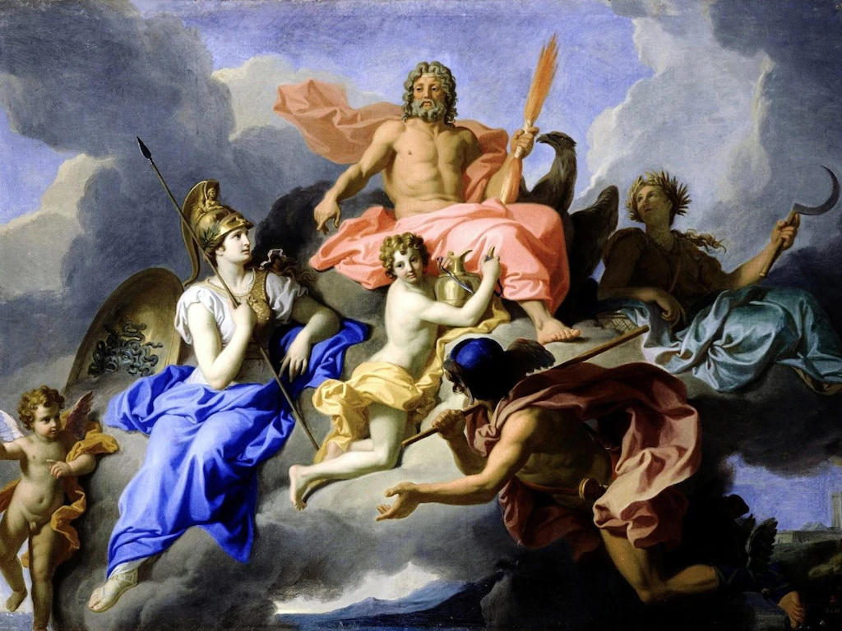
Next Time...
Greeks
Put-Call Parity

